Slide 1
Cassava Leaf Disease Classification using Transfer Learning
Srinath K R
17BCE1217

Slide 2
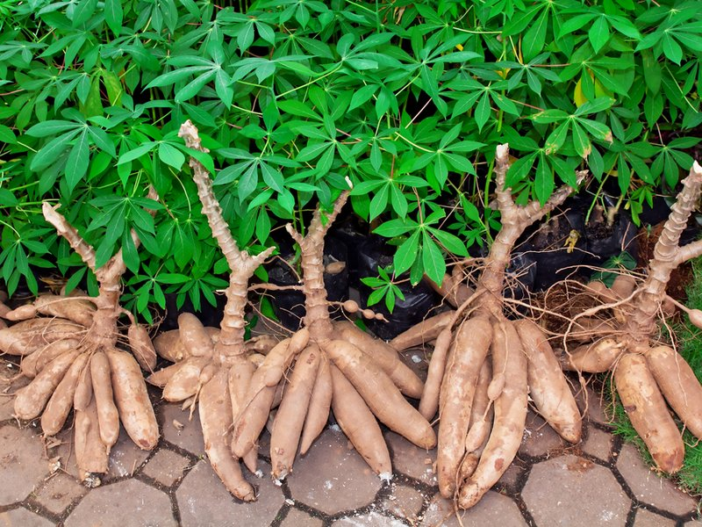
Cassava
A tuberous woody shrub native to South America.
Commonly grown throughout the tropical and subtropical regions of the world.
Very good source of energy and rich in carbohydrates.
Manihot esculenta

Slide 3
Importance of Cassava
Third-largest source of food carbohydrates in the tropics, after rice and maize.
Major staple food in the developing countries, providing a basic diet for over half a billion people.
One of the most drought-tolerant crops, capable of growing on soils with low rainfall.

Slide 4
Some major diseases affecting Cassava
Cassava Bacterial Blight (CBB) - Xanthomonas axonopodis pv. Manihotis.
Cassava Brown Streak Disease (CBSD) - Cassava Brown Streak Virus (CBSV) and Ugandan Cassava Brown Streak Virus (UCBSV), belonging to the Potyviridae family.
Cassava Green Mottle (CGM) - Cassava Green Mottle Virus (CGMV), which belongs to the Secoviridae family.
Cassava Mosaic Disease (CMD) - Cassava Mosaic Virus (CMV), a generic term for many virus species in the Geminiviridae family.

Slide 5
Current disease identification methods
Existing methods of disease detection require farmers to solicit the help of government-funded agricultural experts to visually inspect and diagnose the plants.
This is a labor-intensive, low-supply and costly process.
As a result, an intelligent system for early and precise identification of plant diseases is required.

Slide 6
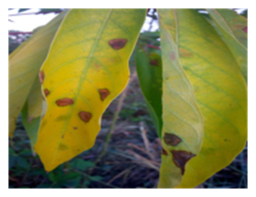
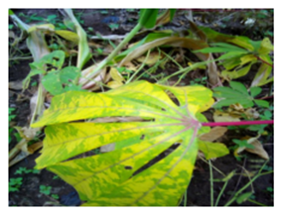
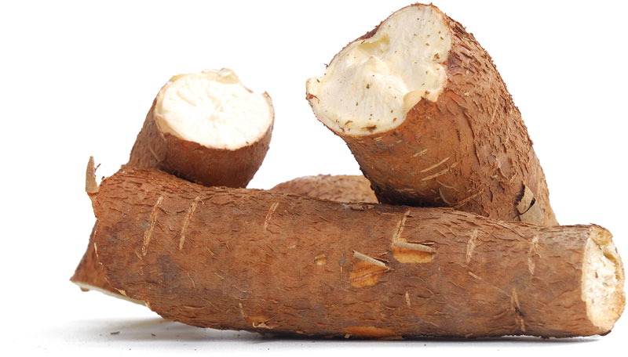
Objective
This study is aimed at classifying cassava image into four disease categories (CBB, CBSD, CGM and CMD) or a fifth category indicating a healthy leaf, using a dataset of 21,397 labeled images collected during a regular survey in Uganda, by applying transfer learning technique on EfficientNet, a state-of-the-art deep convolutional neural network model.

Slide 7
Related work
Sangbamrung, I. et al., (2020) developed a system that performs both classification and object detection on the cassava leaf images dataset. For this, a CNN classification model to classify cassava leaf images as healthy and unhealthy and a faster R-CNN detection model for detecting the affected part of the unhealthy leaves were developed. After detecting the unhealthy part, another CNN classification model was developed to classify the leaves as CBSD and not CBSD.
Sambasivam, G., & Opiyo, G. D. (2021) developed a CNN model from scratch to detect and classify cassava leaf disease images into 5 categories – 4 diseases and healthy. Since the size of the dataset was small and also had a high class-imbalance with a heavy bias towards 2 disease classes, the authors applied various techniques such as SMOTE, modifying class weight, image augmentation to overcome these challenges.

Slide 8
Shortcomings in existing methods
Usage of relatively smaller datasets.
Convolutional Neural Networks (CNNs) were built from scratch which require large amount of resources (time and computation power).

Slide 9
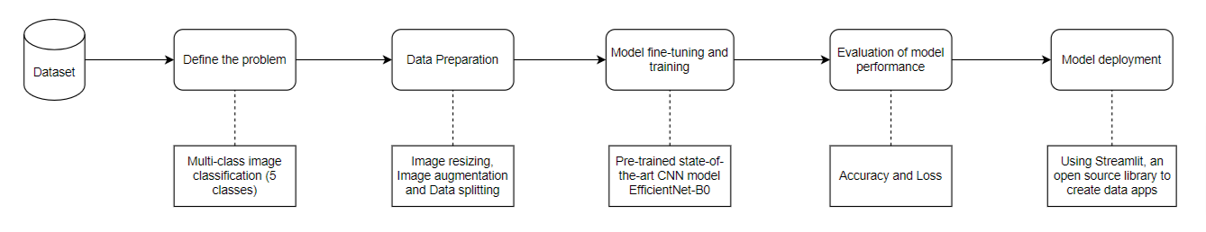
Block Diagram

Slide 10
Proposed method
Resizing of images
Original image size: 800x600
Resized image size: 512x512
Overcoming class imbalance through Image augmentation
Image rotation, Horizontal and Vertical flipping and shifting and shearing transformations.
Data splitting
80% of the images - training.
20% of the images - validation.
Data Preparation

Slide 11
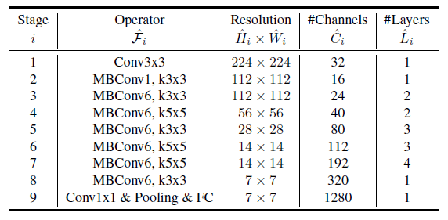
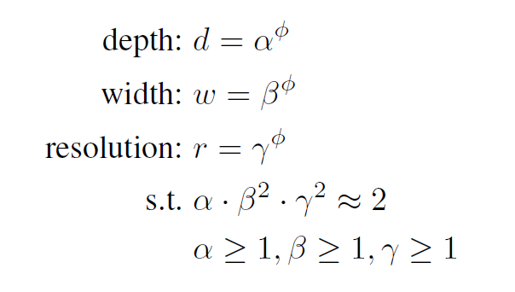
Proposed method (contd.) - Modeling
EfficientNet is a convolutional neural network architecture and scaling method that uniformly scales all dimensions of depth/width/resolution using a compound coefficient. Unlike conventional practice that arbitrary scales these factors, the EfficientNet scaling method uniformly scales network width, depth, and resolution with a set of fixed scaling coefficients.
EfficientNet-B0, the EfficientNet family's baseline model, maximises both accuracy and FLOPS (floating point operations per second).
It includes 237 layers and 5.3M parameters. The EfficientNet-B0 network is built on MobileNetV2's MBConv mobile inverted bottleneck blocks.

Slide 12

Proposed method (contd.)
Evaluation of performance of model
Accuracy (training and validation)
An accuracy metric is used to measure the algorithm’s performance in an interpretable way. It is the measure of how accurate your model's prediction is compared to the true data.
Loss (training and validation)
A loss function is used to optimize a machine learning algorithm. It is the sum of errors made for each example in training or validation sets. Loss value implies how poorly or well a model behaves after each iteration of optimization.
Model deployment
Streamlit is an open-source Python library that makes it easy to create and share beautiful, custom web apps for machine learning and data science.
Streamlit lets you turn data scripts into shareable web apps.

Slide 13
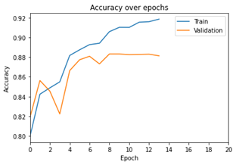
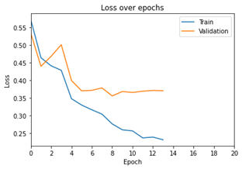
Results
Plot of Accuracy against epochs
Plot of Loss against epochs

Slide 14

Results (contd.)
The proposed model was also made as a submission to Cassava Leaf Disease Classification, the Kaggle Research Code Competition whose dataset was used in this study. Submissions were evaluated based on their categorization accuracy. The test set roughly contains 15,000 images.
Public leaderboard score: 0.8851 (31% of test data)
Private leaderboard score: 0.8887 (69% of test data)

Slide 15
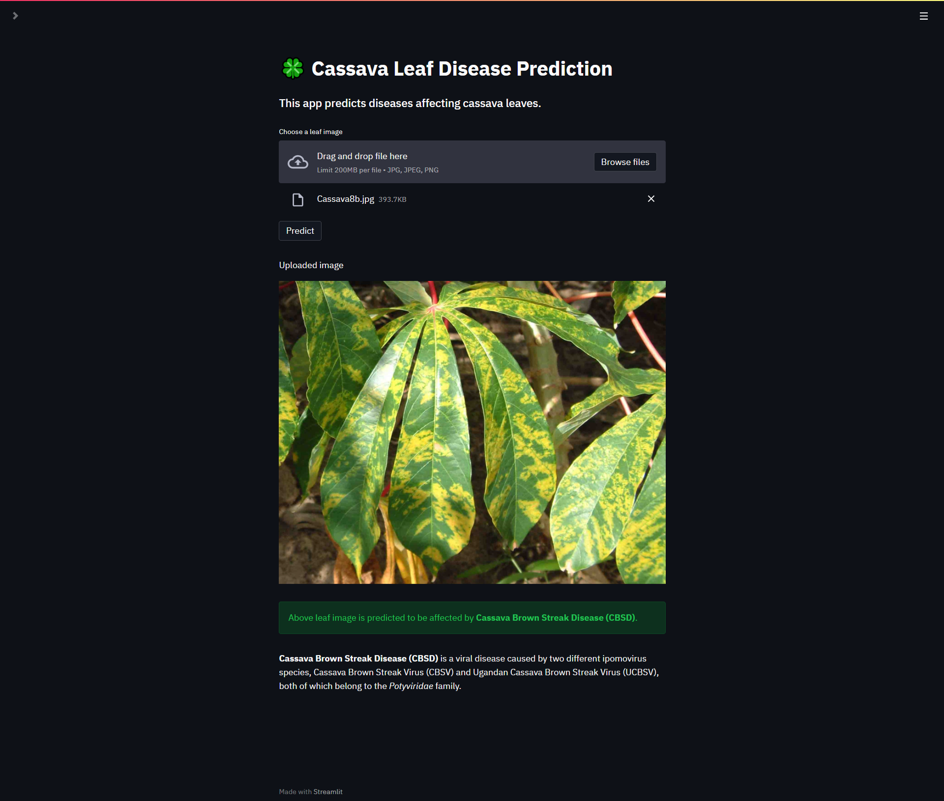
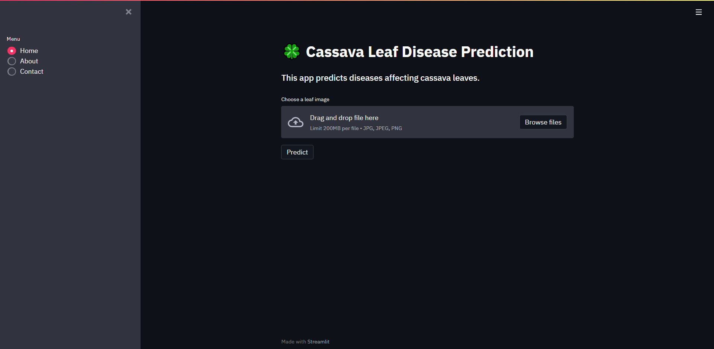
Deployment using Streamlit

Slide 16
References
https://www.kaggle.com/c/cassava-leaf-disease-classification/
Sangbamrung, I., Praneetpholkrang, P., & Kanjanawattana, S. (2020). A novel automatic method for cassava disease classification using deep learning. Journal of Advances in Information Technology Vol, 11(4).
Sambasivam, G., & Opiyo, G. D. (2021). A predictive machine learning application in agriculture: Cassava disease detection and classification with imbalanced dataset using convolutional neural networks. Egyptian Informatics Journal, 22(1), 27-34.
Tan, M., & Le, Q. (2019, May). Efficientnet: Rethinking model scaling for convolutional neural networks. In International Conference on Machine Learning (pp. 6105-6114). PMLR.

